Slide 1
CHICAGO, Illinois
Presentation to Hispanic American construction industry association (HaciA)
July 13, 2022
Notes:
Introduction: Phaedra M Leslie, Patricia Eggleston

Slide 2
Agenda
1
Overview of the project
2
Project Scope
3
Contact Information

Slide 3
Mission statement

Slide 4
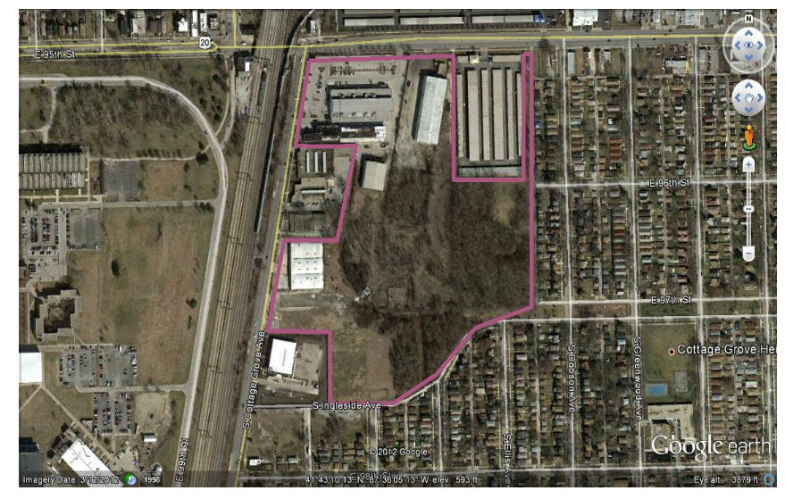
Aerial view – pre-development
Aerial view (Pre-development)

Slide 5
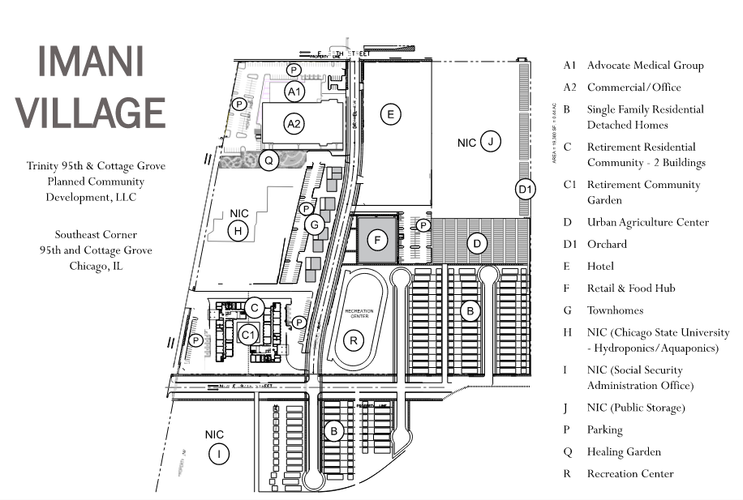
Planned community
Planned community

Slide 6
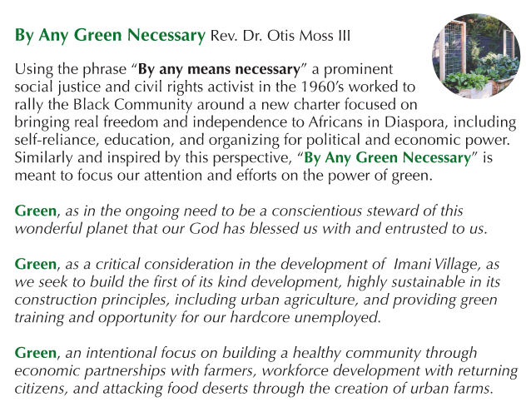
Retirement affordable housing
A sustainable green urban community

Slide 7
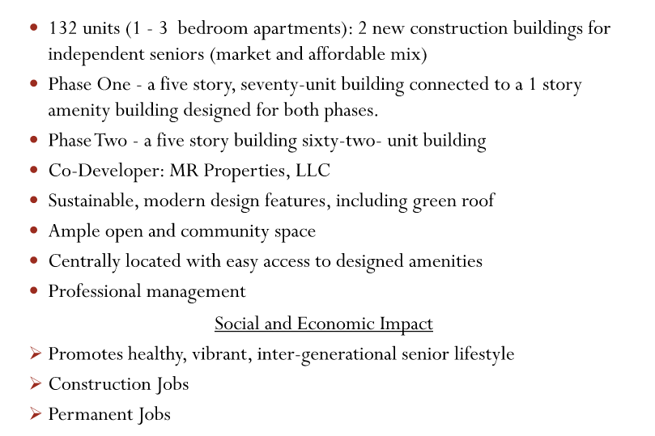
Retirement affordable housing
Retirement affordable housing

Slide 8
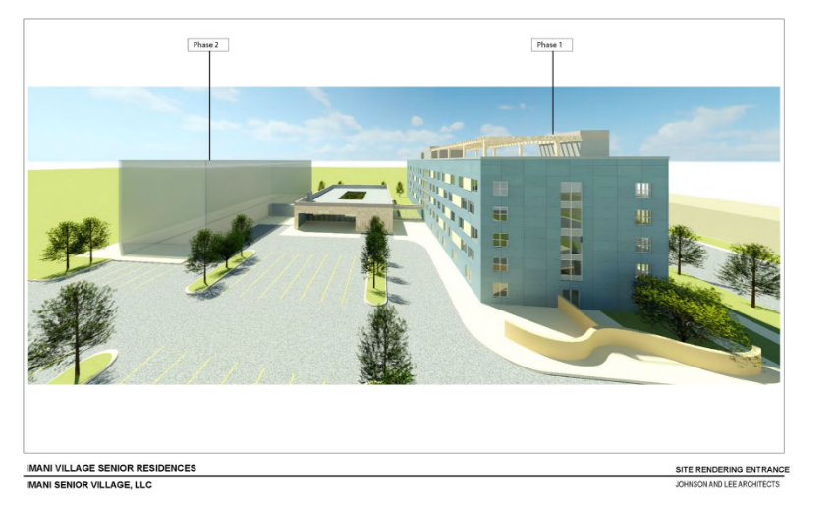
Retirement affordable housing
Retirement affordable housing

Slide 9
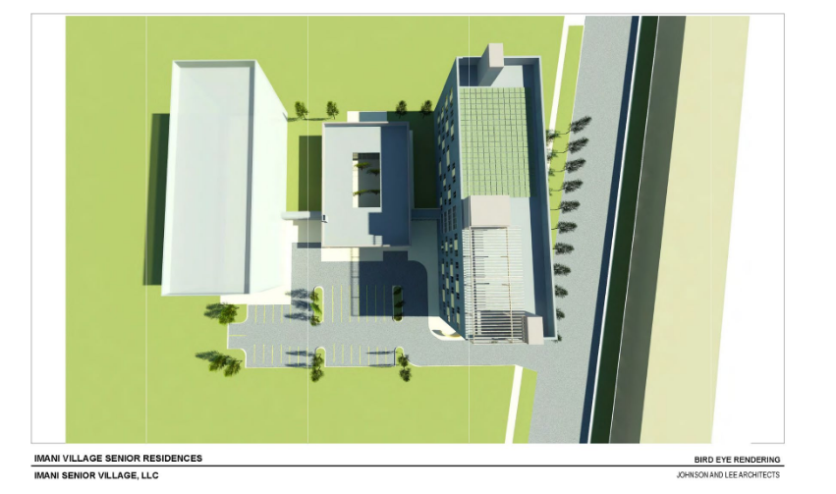
Retirement affordable housing

Slide 10
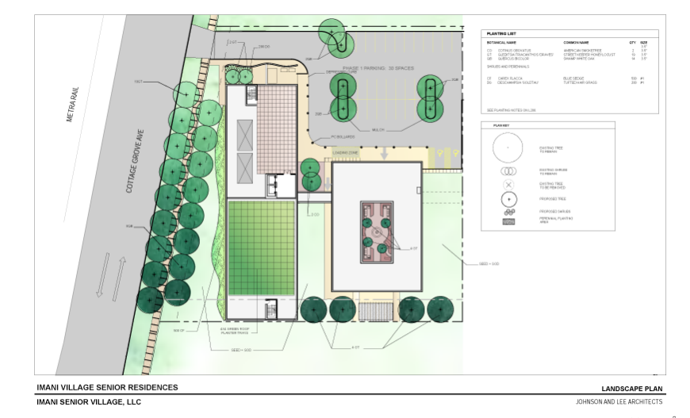
Retirement affordable housing

Slide 11
opportunities

Slide 12
Diversity
PLANNED GOALS
MBE 26%
WBE 6%
Chicago Residency 50%
Local Resident Hiring targeted zip codes 60617, 60619, 60628, 60649

Slide 13
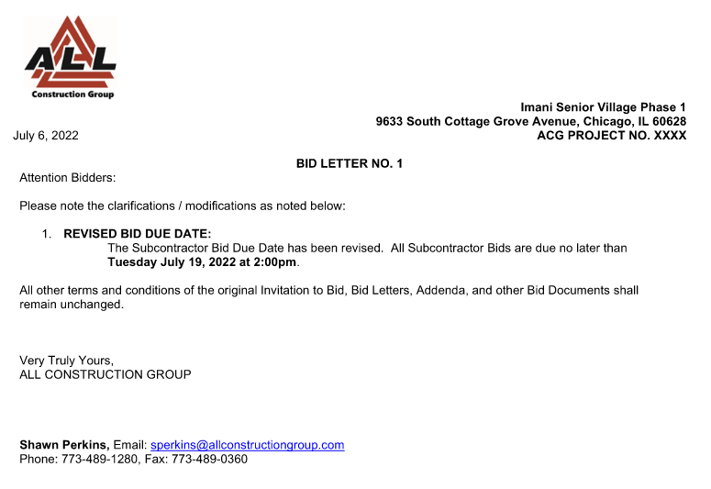
Bid due date
BID DOCUMENTS

Slide 14
contacts
GENERAL CONTRACTOR
ALL CONTRUCTION GROUP
Shawn Perkins, Project Manager sperkins@allconstructiongroup.com
Phaedra M. Leslie, Diversity pleslie@allconstructiongroup.com
Luis Puig, President louis@allmasonry.com
DEVELOPMENT TEAM
Trinity 95th & Cottage Grove Community Development LLC
Pat Eggleston, Executive Director patricia.eggleston@imanivillage.com
Dr. Otis Moss III, Senior Pastor
SPM Properties and Development, LLC.
Phil l Mappa pmappa@mrpropertiesllc.com
Steve Mappa smappa@mrpropertiesllc.com

Slide 15
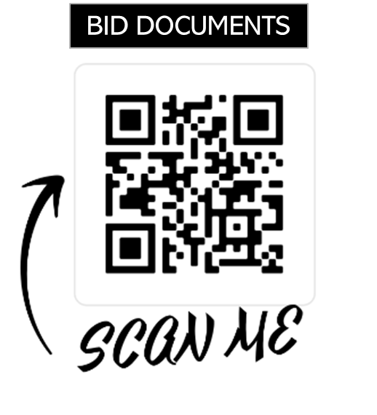
Important links
Imani Village: www.imanivillage.com

Slide 16
Questions
Thank you
General Q&A

