Slide 1
HACIA Presentation
Cook County Bureau of Asset Management
July 13, 2022

Slide 2
Introductions
Bureau of Asset Management
John Yonan, Bureau Chief
Department of Real Estate Management
Jessica Caffrey, Director
Department of Capital Planning and Policy
Earl Manning, Director
Department of Facilities Management
Bilqis Jacobs-El, Director
Department of Procurement
Raffi Sarrafian, Director

Slide 3
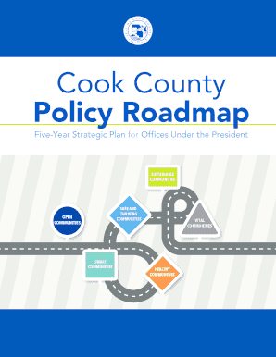
Inclusion, Diversity and Equity
The Cook County policy road map establishes goals and strategies for our work on justice, health, economic development and the environment.
It defines our criteria for serving as responsible stewards of the County’s infrastructure, and establishes the standards of efficiency, transparency and good customer experience that will continue to guide the operations of the County
The County I also committed to having a talented, diverse and productive workforce.
The Policy Roadmap lays out the strategies we use to achieve our goals and the metrics by which we will measure our success.

Slide 4
Department of Real Estate Management Overview
Support asset acquisition, disposition and leasing activity
Work-place strategy design and space planning services
Development management services of real estate assets

Slide 5
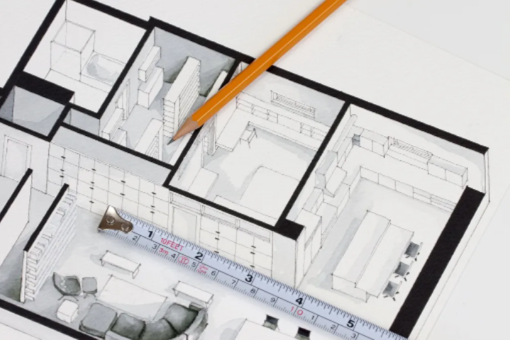
Real Estate Management
Site Assessments
Develop test fit layouts
Site visit with end user and involved BAM team
Take photos and field measurements as needed
Document special needs and concerns from end user
Make recommendations
Space Planning
Make recommendations
Develop test fit layouts with 2 or more possible options if applicable
Meet with end user and BAM team to review and discuss test fit layout options
Make layout revisions as discussed and present for approval
Furniture
Identify possible donated furniture options
Site visit with end user to view donated furniture options that are available
Leasing and Planning
Assist in determining underutilized community assets and aid in planning for future needs
Valuation of assets for potential acquisition/ disposition
Leasing negotiation assistance

Slide 6
Real Estate Management
Services needed
Architects
Surveyors
Planners
Appraisers
69 WW Upcoming needs
Cleaning Service (currently month-to-month) – Quarter 4
Elevator Service (currently month-to-month) – Quarter 3
Contact David Myles at 312 603-0400
Daley Center
Building Landscaping - Quarter 4
Building Environmental Consultant – Quarter 1 2023
Building Pest Control – Quarter 1 2023
Upcoming Projects
EV Infrastructure
Security Upgrades
ADA Courtroom Upgrades
Sheriff Lower-Level Drain Repair
Elevator Machine Room Cooling Installation
Lobby Revolving Door Re-Work
Concourse Level Door Work
Contact John Beatty at 312-656-2313

Slide 7
Department of Capital Planning and Policy Overview
Identify and address critical capital improvements
Establish and implement energy efficiency programs
Modernize building life safety and emergency systems
Oversee construction for traditional real estate and non-traditional infrastructure (e.g. broadband)

Slide 8
Department of Capital Planning & Policy
The Department is responsible for capital construction projects for all County departments and elected officials.
What we do:
Lead planning efforts and right-sizing of real estate footprint
Direct redevelopment projects for the County’s health and hospital system, public safety portfolio and the County’s corporate campus
Develop and deliver Cook County’s Annual Capital Improvement Program

Slide 9
FY2022 Capital Improvement Program by Category & Portfolio
Portfolio | Amount (in millions)
Public Safety | $113.6
Health | $72.8
Corporate | $58.3
Total | $244.7
Amount Requested by User Agencies | $286.3
Amount Recommended | $244.7
Program Category | Amount (in millions)
Redevelopment/Demolition | $79.4
Capital Renewals/Deferred Maintenance | $92.9
Energy/Department Initiatives | $50.2
Life Safety/ADA/Security | $22.2
Total | $244.7

Slide 10
Upcoming Opportunities and Projects FY2022
Corporate Facilities
County Building Renovations
3 AE packages, 6 floors
AE services for exterior renovation
Subcontracting
Dunne Building to open up space for leasing
Interior renovations
Design for façade and windows renovations
Oak Forest – Subcontracting
Evaluation
Health & Hospital
Core Center
JMS Main Loading Doc Modernization
Provident Replacement Hospital – CMaR
Provident – Renovations of Existing Hospital
AE & CMaR for demolition of Polk, Durand, and Hektoen
Strategic Hospitals & DPH Facilities Studies
Stroger Hospital Multiple Renovations – MEP and Roof Replacement CMaR
Public Safety
Medical Examiner – AE Design Services
Courthouses Hardening Design & Construction
DOC Campus ADA AE Assessment & Design Services
Courthouses ADA AE Assessment & Design Services (Target Market)
DOC Campus and Courthouse Roof Replacements
DOC Public Entry Expansion – Design Services
Skokie Courthouse Envelope Renovations
Division IV demolition – Design Services
Countywide
American Recovery Plan Act (ARPA)
Program Management Office (PMO)
Solar and Charging Station Design & Construction
Environmental Assessment Services
Smaller Project Architect and Engineering Services

Slide 11
Department of Facilities Management Overview
Maintain building operations and equipment
Implement energy efficiency programs
Execute preventative maintenance programs
Complete renovations and equipment upgrades

Slide 12
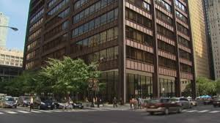
Facilities Management Overview
The Department is charged with maintaining 12 million square feet of Cook County’s physical plant (Does not include Cook County Health or Forest Preserve) which includes the following properties:
Bridgeview Courthouse
Highway Facilities
Maywood Courthouse
Criminal Courts Admin Building
Skokie Courthouse
Hawthorne Warehouse
Markham Courthouse
Rockwell Warehouse
Leighton Court (Criminal Court)
Four Parking Garages
Juvenile Courthouse
LaGrange Auto Facility
Rolling Meadows Courthouse
Jail Complex – 26th & California
Domestic Violence Courthouse
Robert J. Stein Institute
Oak Forest Campus
County Building
Cicero Warehouse
Juvenile Temporary Detention Center

Slide 13
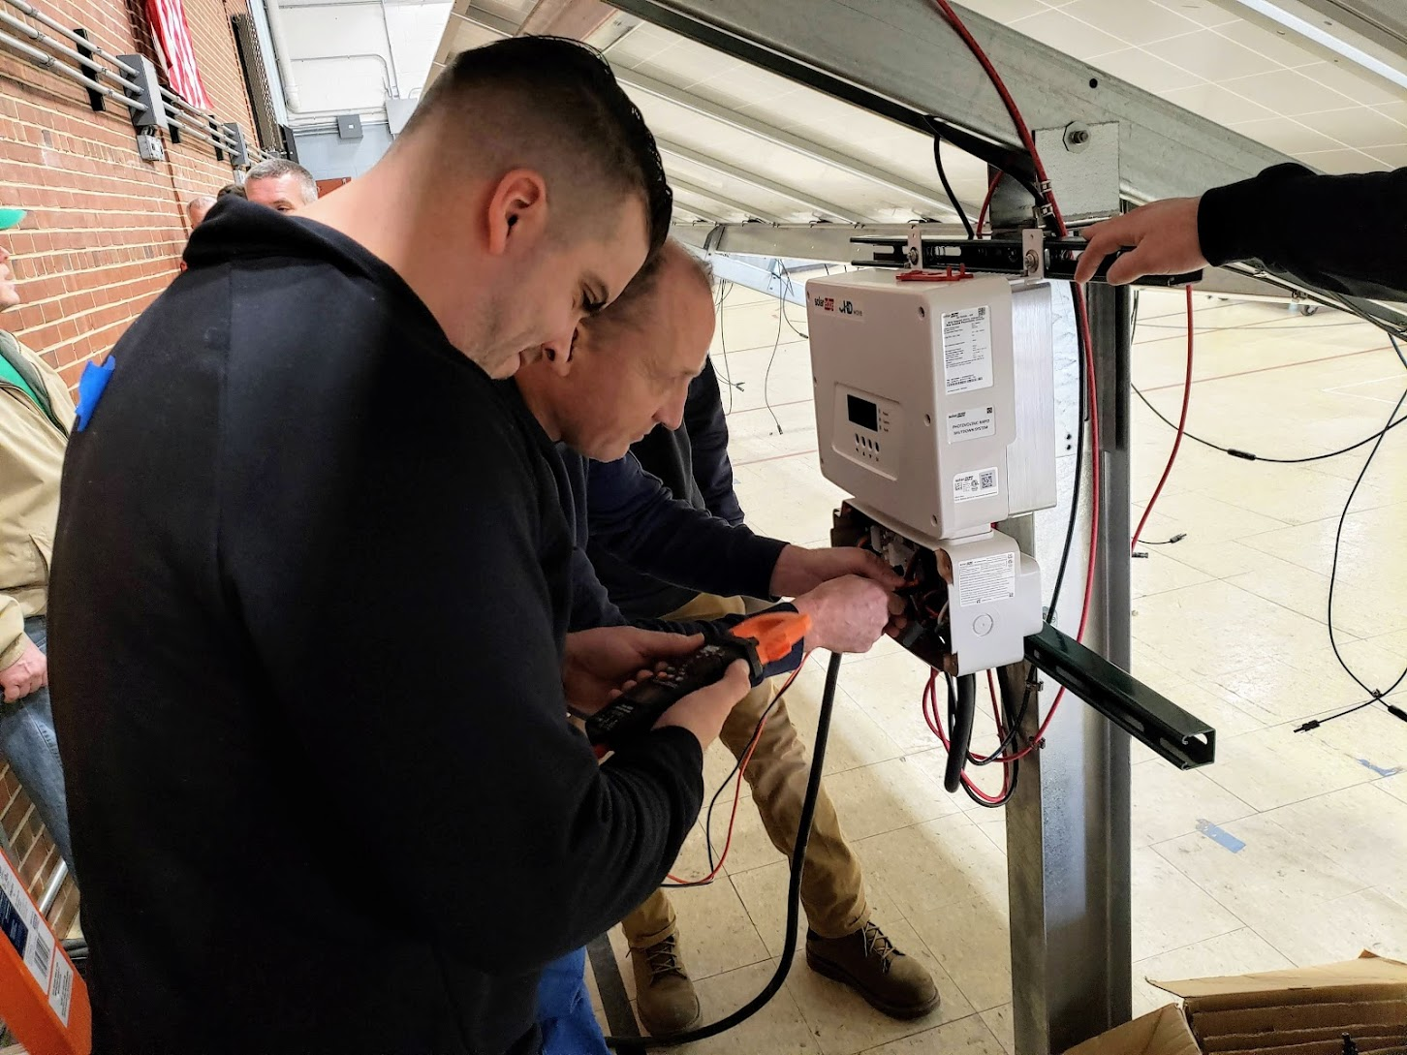
Facilities Management Overview
Supplies & Services comprise 13% of DFM budget, or $7,300,000.
Services | Supplies
Landscaping | Lumber
HVAC/Controls | Pumps
Pest Control | Paint & Paint Supplies
Elevator Maintenance | Rock Salt & Deicer
Waste Removal | Filters
Roofing | Carpeting
Window Washing | Janitorial Supplies
Grease Trap/Sewer – Vac Truck | Paper Products (towels & toilet tissue)
Overhead Door Service | Uniforms
Flagpole Maintenance | Trash Liners
Sample Service Contract
Sample Supply Contract

Slide 14
Needed Areas of Participation
Supplies
Watts Plumbing Supply Catalog
Motors - Catalog Contract (Various Manufacturers
Master Lock Products
Paint Sundries
V Belts
Salt Pellets
Stanley Best Access Supplies
Bronze Copper and Brass Fittings
Wallboard and Insulation Products
Rock Salt/Deicing Salt
Work Gloves
Commodities
Rooftop Units
Forklift Trucks
Custodial Floor Care Equipment
Services
Annual Fire Pump Testing & Maintenance
Annual Fire Extinguisher Certification Inspections/Testing
Annual Fire Alarm Testing, Inspections and Battery Replacement ▪ Chiller Maintenance
Refrigeration Equipment Maintenance Grease Trap Pump Services
Overhead Door Preventative Maintenance and Repairs
Architectural Metal Cleaning/Maintenance
Scavenger and Recycling Services Elevator Inspection Services

Slide 15
Upcoming Opportunities and Projects FY2022
Opportunities Currently out to Bid
Interactive Touchscreen Directory at various locations
Opportunities – 3rd quarter
Power tools catalog contract
Watts Plumbing Supplies
Architectural metal cleaning services
Chiller Maintenance at DOC
Refrigeration Equipment Maintenance
Rock Salt/Deicing salt
Opportunities 4th quarter
Fire Alarm Testing
Fire Pump Testing
Fire Extinguisher Testing
Repair and service of overhead doors
Elevator inspection services
Door & Lock catalog contract
Scavenger & Recycling services

Slide 16
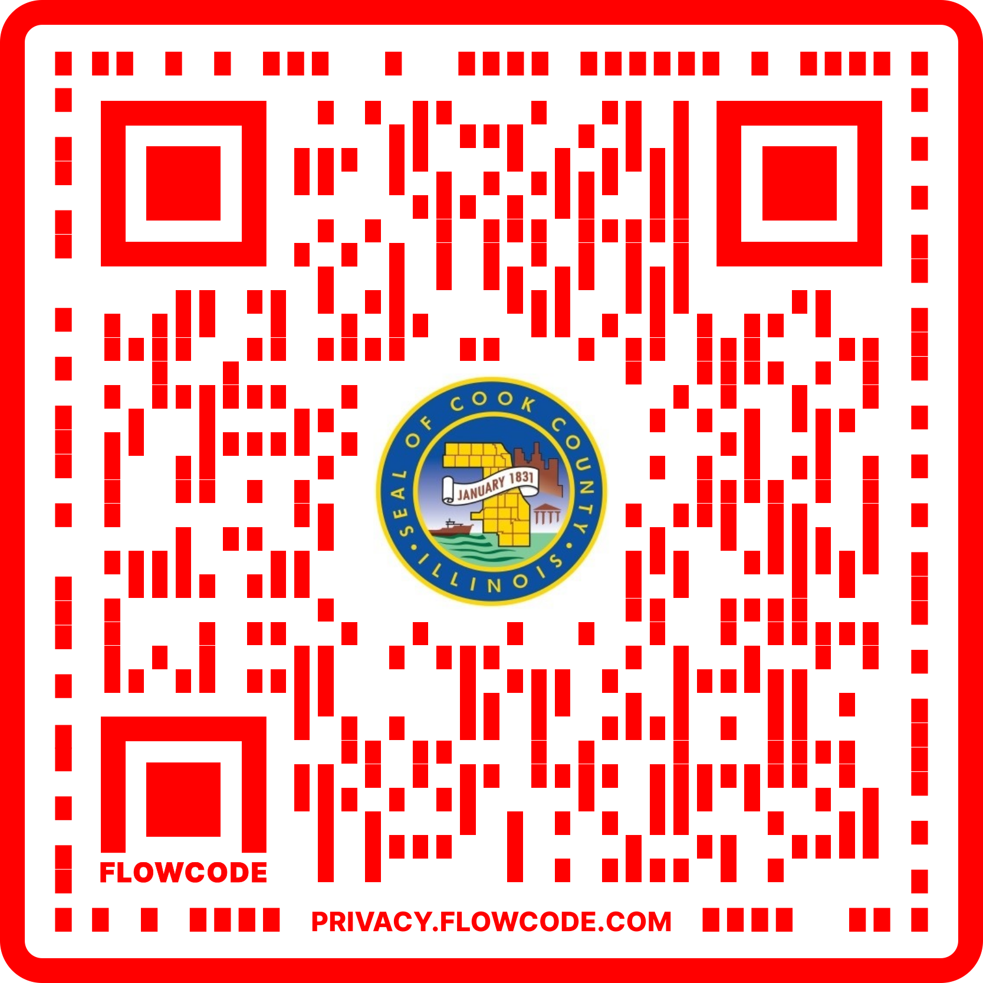
Contract Opportunities
Forecast Opportunities
Check our website for our annual Buying Plan
Buying plan lists opportunities for the coming year
Our Countywide Buying Plan for FY21 will be released soon
Current Contract Opportunities
View our Contract Opportunity Page
Sign up in the OCPO Vendor Database to receive notifications regarding current solicitations that are posted
Awarded Contracts
Review our Awarded Contracts and Amendments database to see when a contract expires
Be sure to review the renewal periods that typically extend a contract by one or two years
This database can be search using keywords, contract numbers, vendor names, and more

Slide 17
MBE/WBE Compliance Goals
MBE/WBE Aspirational Goals
Goods/Services Contracts: 25% MBE and 10% WBE
Construction Contracts: 24% MBE and 10% WBE
All Professional Service Contracts: 35% overall
Goals are always a function of availability of MBE and WBE vendors capable of performing on the contract.
Certification
If you are not yet MBE/WBE certified, please start the process as soon as possible
If you are MBE/WBE certified, carefully look at the scopes of work and review past bids
Certification is not required to participate in County Contracts
Our total contracting dollar goals are 10%. We have a personal goal to increase to 15% and would like to accomplish this with your help.

Slide 18
Contact Information
Bureau of Asset Management
Belinda Henderson
Executive Assistant to Director
Department of Facilities Management
69 W. Washington, Suite 3100
Chicago, IL 60602
Belinda.Henderson@cookcountyil.gov
Office of the Chief Procurement Office
Ericka White
69 W. Washington, Suite 3000
Chicago, Ill. 60602
Ericka.White@cookcountyil.gov

Slide 19
Questions?

