Slide 1
Route to Procurement: Congress Branch & Beyond
2022

Slide 2
CTA Diversity Small Business Programs
Disadvantaged Business Enterprise (DBE)
Small Business Enterprise (SBE)
Accepted certifications:
CTA (SBE/DBE)
Metra (SBE/DBE)
Pace (SBE/DBE)
City of Chicago (DBE)
Illinois Department of Transportation (DBE)
Workforce
Mentor/Protégée
Technical Assistance
CTA Contracting Strategies
Contract Research
Marketing to the Primes
Access to Capital

Slide 3
Workforce
This unit works collaboratively with key stakeholders to provide opportunities in the trades and professional service industry.
Construction Goals
Professional Services
Careers Opportunity Goal – Section 3 workers & Workforce Innovation & Opportunity Act (WIOA)-enrolled
Union Apprentice Goal – Union apprentices
Economically Disadvantaged Area Goal (EDA)
Candidates residing in zip codes with a median income of $45K or less (CTA Service Area)
Economically Disadvantaged Area Goal (EDA)
Candidates residing in zip codes with a median income of $45K or less (CTA Service Area)
https://www.transitchicago.com/dbe/workforce-initiatives/

Slide 4
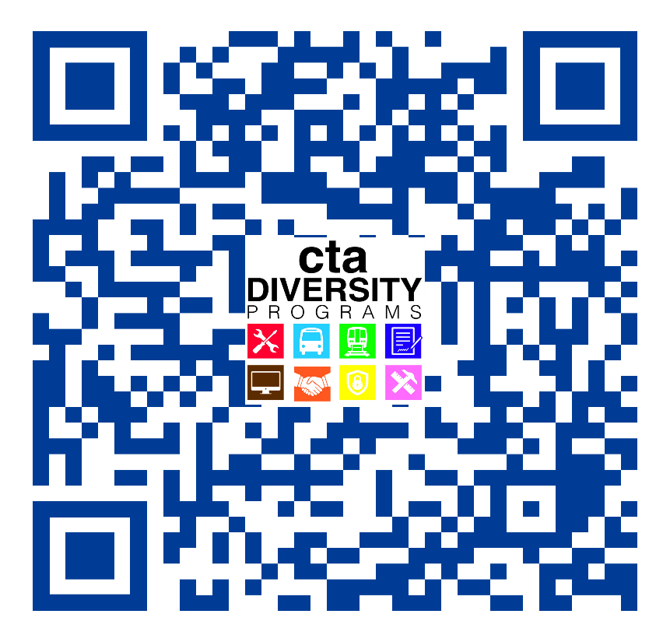
How To Prepare For Upcoming Opportunities
Register as a vendor with CTA
https://cta.dbesystem.com/
DBE certification
Procurement Portal
https://transitchicago.bonfirehub.com/portal/tab=openOpportunities
Networking Events
Meet with prime contractors on CTA projects and begin to build valuable business relationships

Slide 5
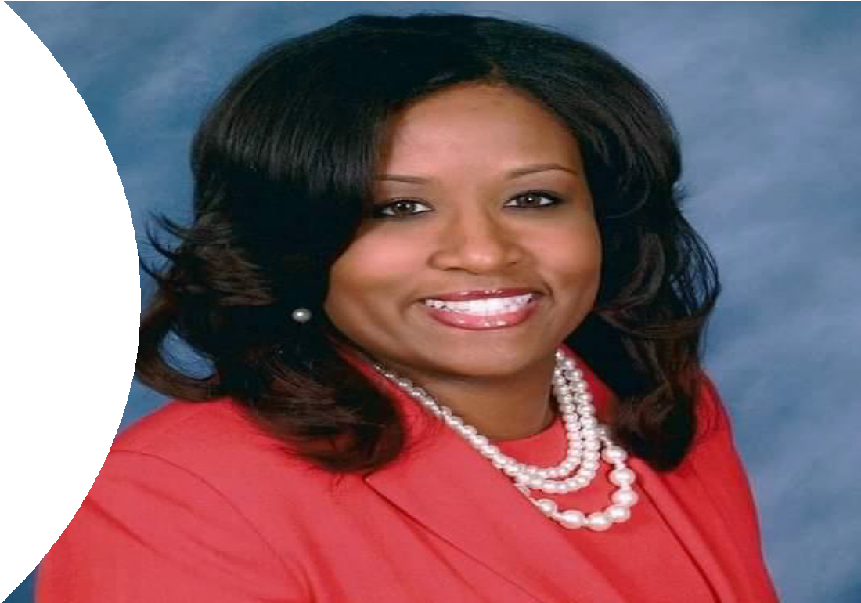
Capital Construction
TaNesheha Marshall, P.E.
Vice President, Capital Construction

Slide 6
General Engineering Consultant Services
Provides design for CTA construction projects
Task order based contract; task order based DBE goals
Subcontracting Opportunities: Engineering & Architectural Service, Systems Analysis, Survey, Geotech, Specialty Projects (e.g., Noise & Vibration)
15 Pre-Approved General Engineering Consultants in a Two Tier Award System.
Total contract authorization up to
$132M
Contract duration is 5 years
15 Pre-Approved GECs
Tier 1
(>$20M of Constructed Value & > 4/5 Engineering Disciplines)
AECOM Technical Services, Inc.
eXP US Services, Inc.
HNTB Corporation
TY Lin International Great Lakes, Inc.
WSP USA Inc.
Tier 2
(<$20M of Constructed Value & < 4/5 Engineering Disciplines)
A. Epstein and Sons International, Inc.
Alfred Benesch & Company
CDM Smith, Inc.
Facet Engineering, LLC
HW Lochner, Inc.
LTK Engineering Services
Michael Baker International, Inc.
Muller & Muller, Ltd.
Simpson Gumpertz & Heger, Inc.
TranSystems Corporation

Slide 7
General Engineering Consultant Services
Recently Executed Task Orders
Blue Line O’Hare - Harlem Bus Bridge Reconstruction:
Commitment 38.04%
Blue Line Congress - Morgan Substation & Racine Station ASAP:
Committed 29.04%
Blue Line Congress - Track Improvements:
Committed 27.82%
Blue Line Logan - California ASAP:
Committed 35.58%
Blue Line O’Hare - Montrose ASAP:
Goal 30%
Blue Line Congress - Des Plaines Yard Improvements:
Committed 29.88%

Slide 8
Small Business Enterprise – SBE/GEC
Surveying (Category 1)
American Surveying & Engineering
Atlas Engineering Group
The Roderick Group
Geotechnical (Category 2)
Design Consulting Engineers
GSG Consultants
Architecture (Category 3)
Altus Works
Muller & Muller
Studio ARQ
7 SBE contracts awarded in the last 12 months:
Congress Lidar Survey
Congress Geotechnical &
Environmental Investigations
Congress Site Survey
Congress Utility & Inspection
California ASAP Survey
Kedzie Bus Garage Repairs Architecture Plans
Forest Glen Garage Demolition
Contract Document Prep

Slide 9
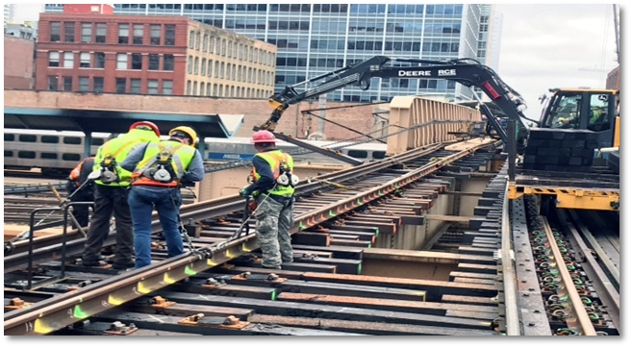
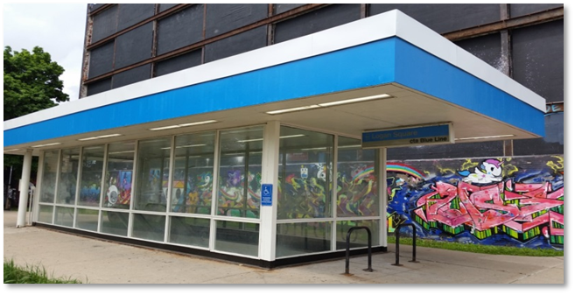
Construction Management
Provides oversight management on CTA construction projects
Task order based contract with DBE goals
10 Pre-Approved Consultant Managers
AECOM Technical Services
Arcadis, US, Inc.
The Roderick Group (Ardmore Roderick)-DBE
HNTB Corporation
Jacobs Engineering Group
Omega Baker JV
SQN Associates LLC-DBE
STV, Inc.
Transystems/Tylin JV
WSP USA

Slide 10
Upcoming CM Task Orders
Project Name | Procurement
Midcon 1 (Stations & Facilities) | Q1-2022 (Advertised 3/18/2022)
Midcon 2 (Civil, TP & Systems) | Q1-2022 (Advertised 3/18/2022)
Adjacent | Q1-2022 (Advertised 3/18/2022)
YNB Signals Closeout | Q1-2022 (Advertised 3/25/2022)
Control Center | Q3-2022
Harlem Bus Bridge | Q3-2022
ASAP-Austin | Q1-2023
ASAP-California | Q1-2023
ASAP-Montrose | Q2-2023

Slide 11
Mid - Level Construction (MIDCON)
Work orders range from $1M - $15M; work order-based DBE goals
Tier One (Projects $3M or Greater)
Aldridge Electric, Inc.
Granite Construction Company
ICC Group, Inc.
Kiewit Infrastructure Co.
Tier II (Projects Under $3M)
Anchor Mechanical, Inc
Foundation Mechanics, LLC (DBE)
Old Veteran Construction, Inc. (MBE)
RailWorks Track Service, Inc.
W.E. O’Neil Construction
The term of service for this Midcon Contract is two (2) years with three (3) one-year options. The expected duration of each Work Order will be described in each Work Order solicitation.

Slide 12
Mid – Level Construction (MIDCON)
Types of Projects Include:
Track Replacement
Station Improvements
Electrical
Civil/Structural
Infrastructure Upgrades
Facilities Renovations
Subcontracting Opportunities: Demolition, Hauling, Crane Rental, Drainage, Concrete, Masonry, Steel, Structural & Architectural Metals, Guardrails, Openings, Canopy, Roofing, Painting, Plumbing, Mechanical, Electrical, Signal, Special Track Work, Electrical, Traction Power, Signage, Traffic Control

Slide 13
Upcoming Midcon Work Orders
Project Name | Midcon Tier | Procurement
Skokie Shops | Tier 1 (CM Midcon 1) | Q2-2022
95th UST removal | Tier 2 (CM Midcon 1) | Q2-2022
Traction Power Upgrades | Tier 1 (CM Midcon 2) | Q3-2022
Kedzie Garage | Tier 2 (CM Midcon 1) | Q3-2022
Lake Track Improvements | Tier 1 (CM Midcon 2) | Q3-2022
Cicero Grade Crossing | Tier 2 (CM Midcon 2) | Q4-2022
Forest Park Yard | Tier 1 (CM Midcon 2) | Q4-2022
Substation Roofs, Phase 2 | Tier 2 (CM Midcon 1) | Q4-2022

Slide 14
Station and Infrastructure
Investments

Slide 15
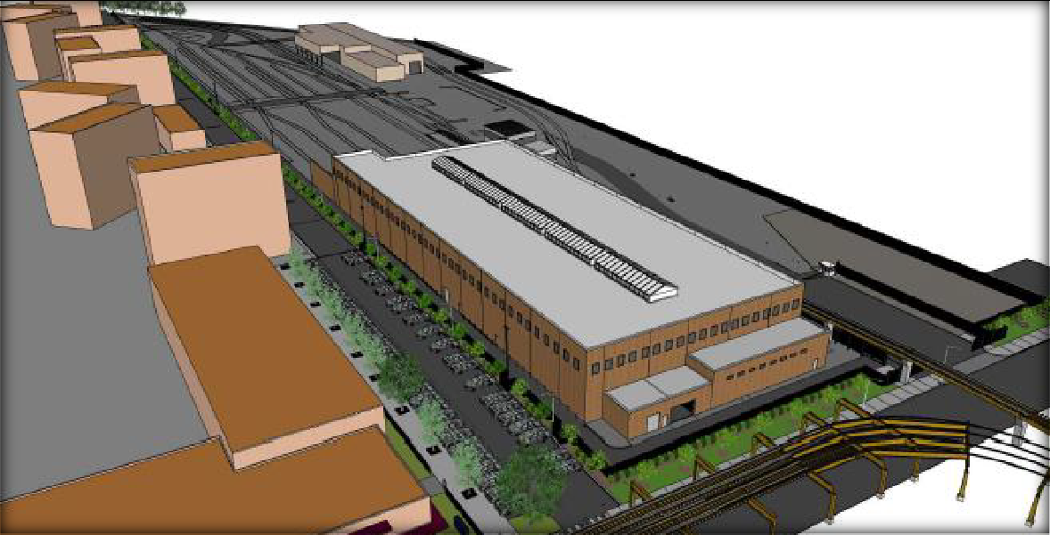
Non-Revenue Vehicle Maintenance Facility
Project Scope:
Construction of a new facility for maintenance and repair of power and way equipment used for right-of-way maintenance
Located at CTA 63rd Lower Yard, includes site improvements to accommodate the building and
other site usages
Program Budget:
$70 Million
Program Schedule:
Clark Construction
Construction 2022-2023

Slide 16
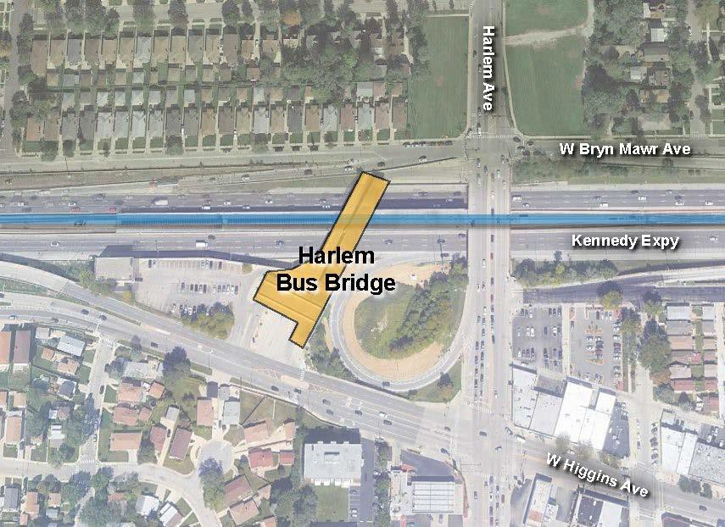
Blue Line – Harlem Station Bus Bridge
Project Scope:
Bring elements of the Bus Bridge and adjacent bus lane up to a state of good repair
Structural inspection, repair recommendations, and land survey
Remove and reconstruct the existing Harlem Bus Bridge structure spanning over I-90 Kennedy
Expressway
Program Budget:
$37 Million
Program Schedule:
GEC awarded-HNTB
Construction 2023 – 2024

Slide 17
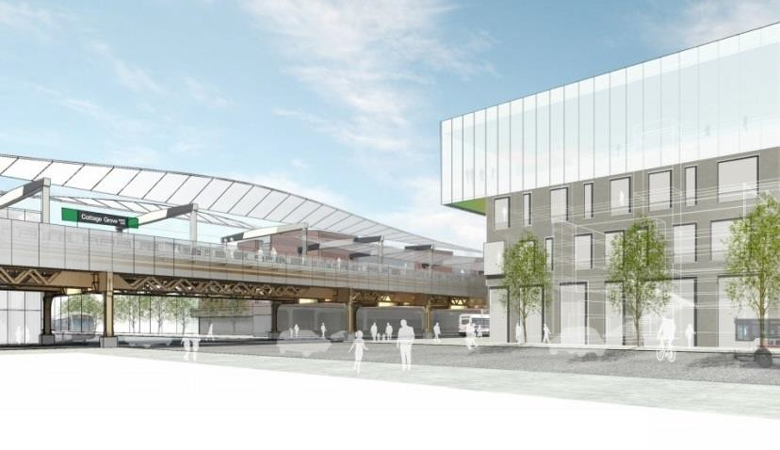
Green Line – Cottage Grove Station
Project Scope:
Stationhouse relocation within a private developer’s new mixed-use development
New pedestrian bridge and canopy to connect to the existing platform
General station upgrades for state-of-good repair and customer-facing improvements
Program Budget:
$75 Million
Program Schedule:
GEC awarded-Tylin
Construction 2023 – 2024

Slide 18
Blue Line – Congress Project Phase 1
Project Scope:
Complete removal and replacement of mainline track and traction power from Dearborn Subway South Portal to the Illinois Medical District Station to remove slow zones
New Substation at Morgan Street and upgrades to the current Hermitage Substation
Renovation of Racine Station for state-of-good repair and accessibility
Program Budget:
$178 Million
Program Schedule:
SBE’s awarded-ASE, Atlas,
Roderick Group, Design Consulting
GEC’s awarded-AECOM & HNTB
Construction 2023 – 2025

Slide 19
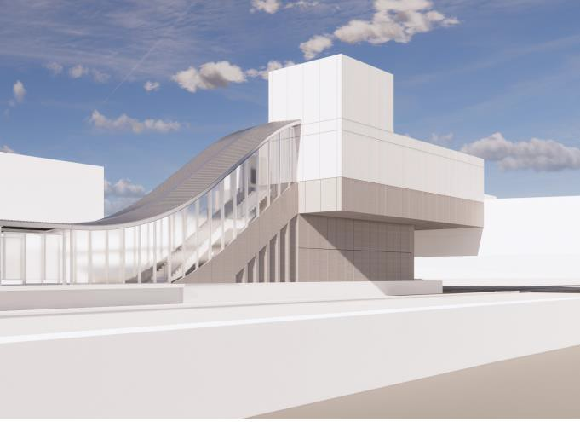
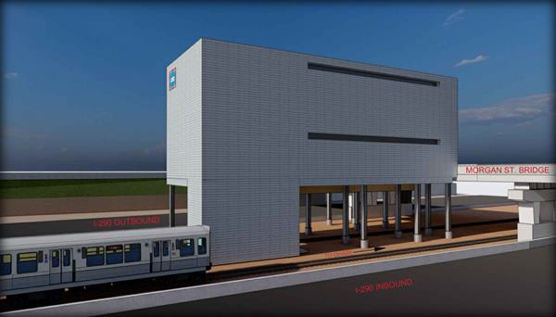
Blue Line - Racine Station
Rendering of new Racine Station house from expressway level
Rendering of new Morgan Substation

Slide 20
All Stations Accessibility Program (ASAP)
Program Budget:
Total Twenty-Year Cost: $2.1 Billion
Phase One: $140.3 Million
Program Schedule:
Phase One project completion dates range between 2020-2024
ASAP Program Scope
The goal of ASAP is to make the system completely accessible to people with disabilities in the next 20 years.
Forty-two stations are inaccessible and are included
either in ASAP or in one of CTA’s other major programs.
ASAP Phase One includes eight (8) prioritized stations.

Slide 21
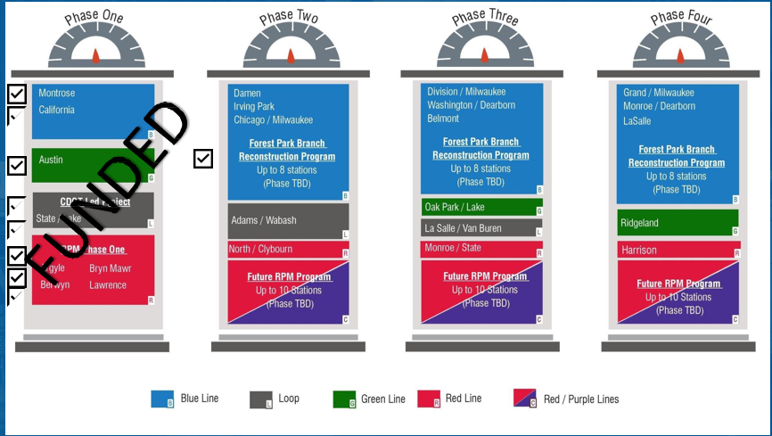
Nine (9) stations fully funded and in implementation

Slide 22
ASAP Phase 1 Station Overview
Station | Status | Projected Construction
Racine Station (Blue Line) | 75% Design | Q1 2023 – Q4 2025
Austin Station (Green Line) | 30% Design | Q3 2023 – Q4 2024
California Station (Blue Line) | Design Started | Q3 2023 – Q4 2024
Montrose Station (Blue Line) | Design in Procurement | Q1 2024 – Q3 2025
State/Lake Station (Elevated / CDOT) | Design in Progress | TBD
RPM Stations (Lawrence, Argyle, Berwyn, and Bryn Mawr)

Slide 23
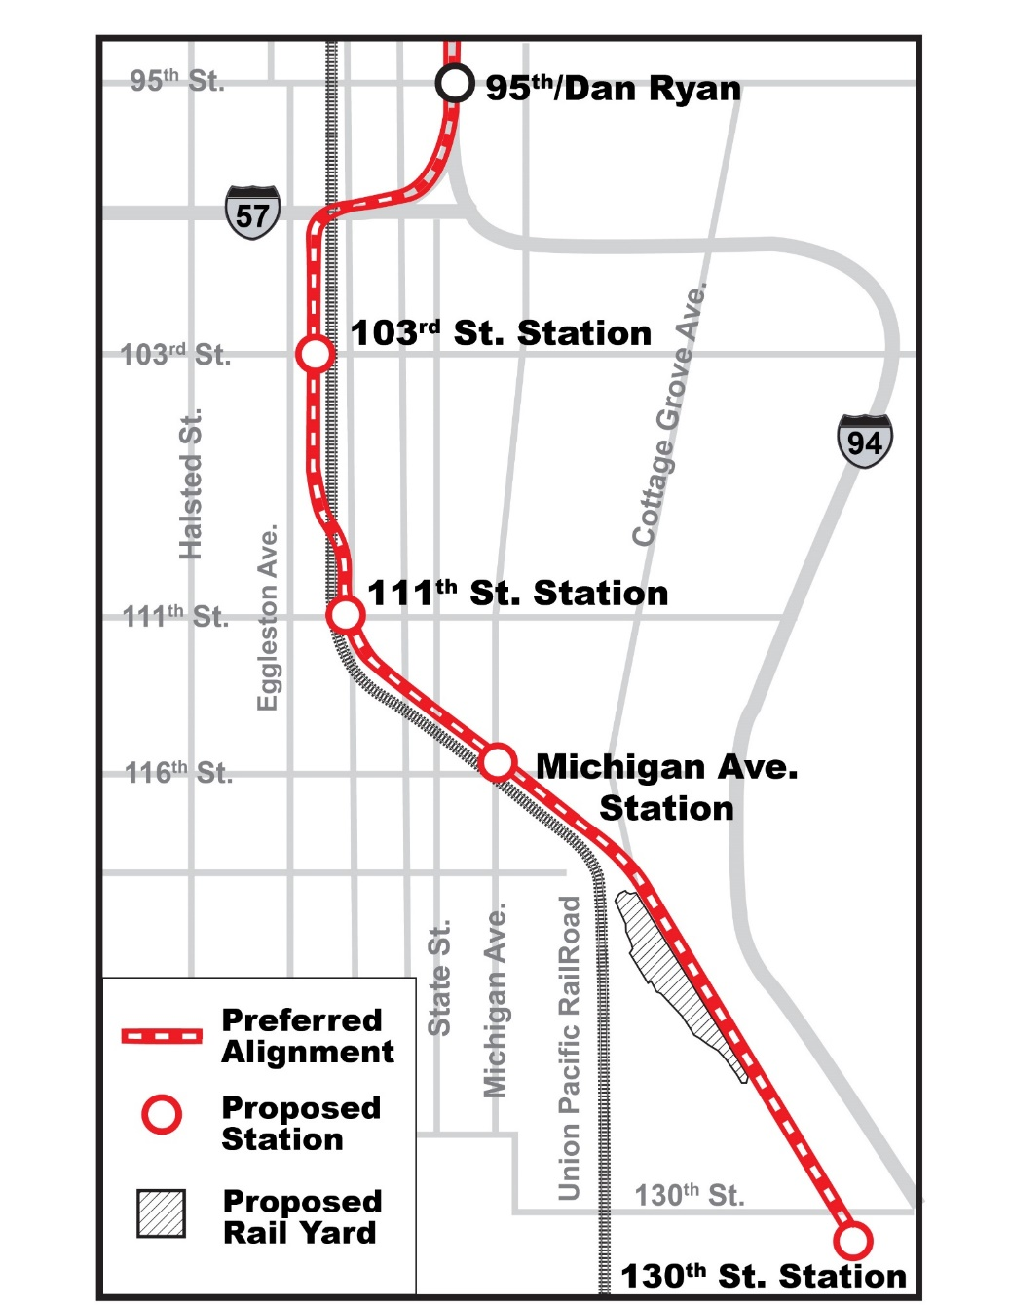
Red Line Extension
Construction Management & Professional Services Contracting Opportunities

Slide 24
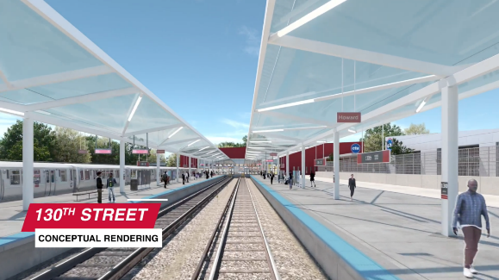
Project Overview
Project Scope
5.6-mile heavy rail extension
Four new stations:
103rd Street (near Eggleston)
111th Street (near Eggleston)
Michigan Avenue (near 116th Street)
130th Street (at Altgeld Gardens)
Multimodal connections at each station including bus, bike, pedestrian, and park & ride facilities
Train storage yard and maintenance facility at 120th Street

Slide 25
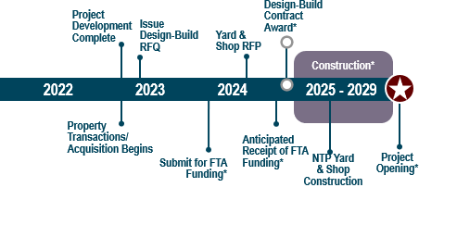
Anticipated Project Schedule
Federal Transit Administration approved entry in New Starts Project Development (PD) phase of Capital Investment Grants Program in December 2020

Slide 26
Red Line Extension (RLE) Advance Work Procurements
Red Line Extension (RLE) Advance Work Procurements
Property Management Services
RFP anticipated in Q2 2022
SBE Simple Building Demolition Work Order Contract
Multi-Firm Prequalification Contract for non-complex or smaller demo packages awarded to SBE firms
RFP anticipated in Q3 2022
Complex Building Demolition & Remediation Work Order Contract
Multi-Firm Prequalification Contract for complex demo packages
RFP anticipated in Q3 2022

Slide 27
CM for Demolition Oversight
A Single Construction Manager (CM) will oversee the demolition and remediation work.
The Construction Manager will be procured through a task order under the new CTA CM Blanket Contract.
This is anticipated to be released for proposals in to pre-qualified firms in Q4 2022.
The CM will oversee multiple Demolition and Remediation work orders:
Multi-Firm Prequalification Contract for non-complex or smaller demo packages awarded to SBE firms
Multi-Firm Prequalification Contract for complex demo packages
Work orders (for one or more building demolition/remediation scopes) would be issued to the prequalified firms
RFPs anticipated in Q3 2022

Slide 28
RLE GEC Task Orders
General Engineering Consultant (GEC) Opportunities
Tier 1 of GEC
Design of the 120th Yard & Shop
Proposals anticipated to be requested in Q3 2022
Tier 2 of GEC
Complex Property Demolition & Site Remediation Design Packages
Proposals anticipated to be requested from Q4 2022 to Q3 2023
Small Business Enterprise (SBE) Architectural Blanket
Simple Building Demolition Design Packages
Proposals anticipated to be requested from Q4 2022 to Q3 2023

Slide 29
RLE Design Build Contract
RLE Design-Build Contract
Scope: Final design and construction of mainline ROW, structures, tracks, signal system, traction power system, stations and parking facilities
Two-Step Procurement:
Request for Qualifications anticipated in Q4 2022
Shortlist Notification to occur in mid-2023
Request for Proposals issued to short-list firms
RLE Design-Bid-Build Construction Contract
Scope: Construction of 120th Yard and Shop
Request for proposals anticipated in Q3 2024

Slide 30
RLE Owners Representative (OR) Contract
Owners Representative (OR) will oversee Design-Build (Mainline) and Design-Bid-Build (Yard & Shop) Contracts; Advance Utility Work; Environmental Remediation
OR will advise CTA and act on their behalf, ensuring 1) the successful completion of the project, and 2) that the owner’s interests are represented in every decision in each phase of development, including:
Bidding
Design
Construction
Post-Construction
Close Out
Request for Letters of Interest & Qualifications (LIQ) anticipated in Q3 2022

